Slide 1
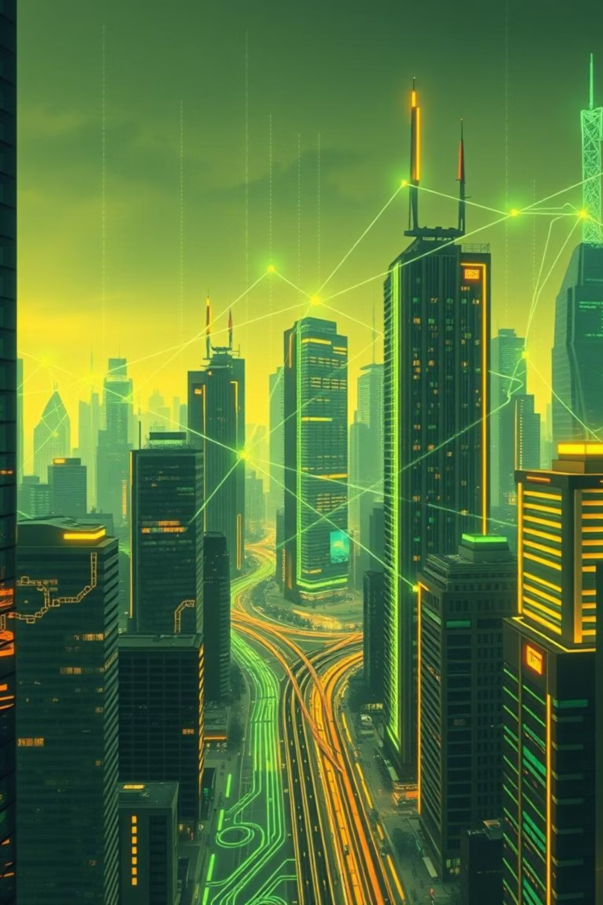
Machine Learning Overview: From Theory to Real-World Impact

Slide 2
The Genesis of Machine Learning
1950: Alan Turing's Vision
1
Turing poses the foundational question: "Can machines do what we (as thinking entities) can do?", laying the groundwork for artificial intelligence.
2
1959: Arthur Samuel Coins "ML"
While developing a checkers-playing program that improves by playing itself, Arthur Samuel introduces the term "Machine Learning," marking a pivotal moment.
1997: Mitchell's Definition
3
Tom Mitchell formally defines Machine Learning as computers improving performance (P) on tasks (T) through experience (E), a widely accepted modern view.

Slide 3
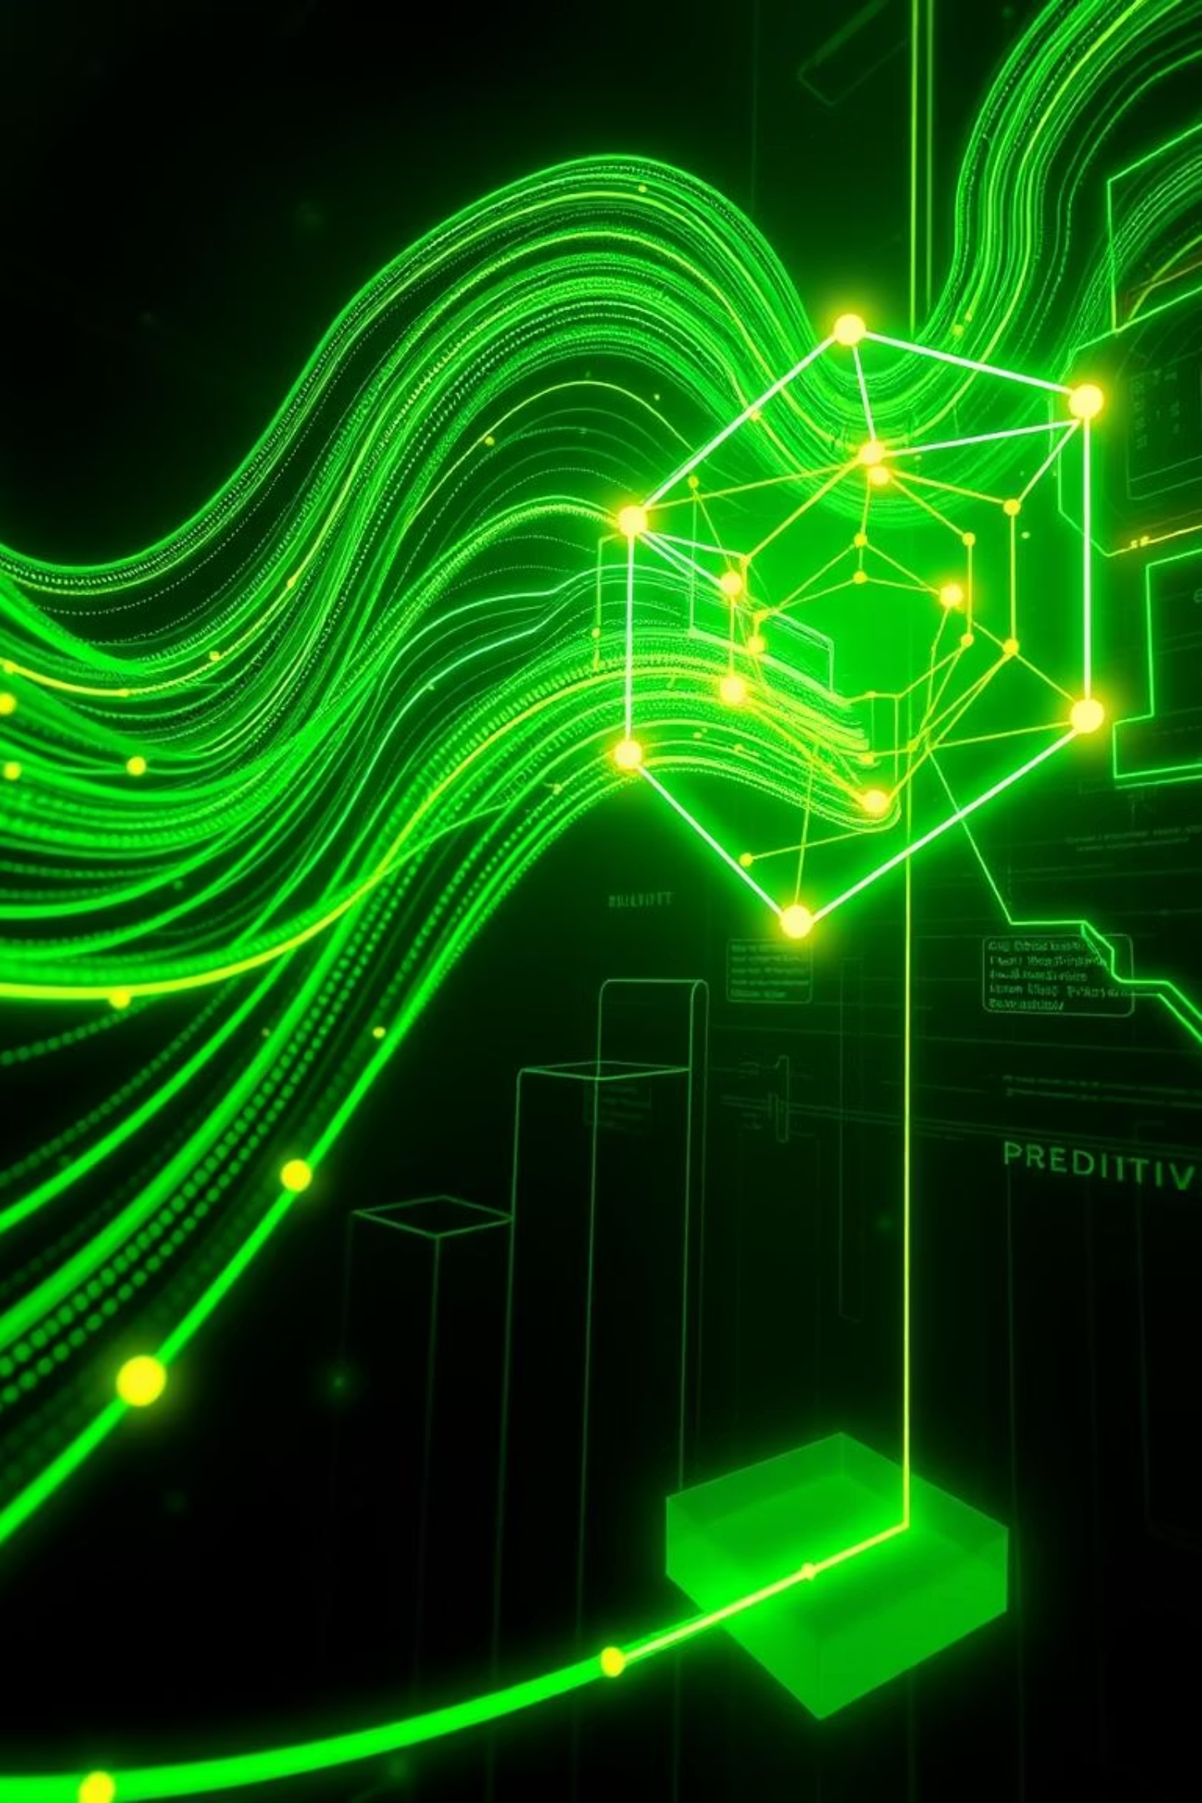
Demystifying Machine Learning
What It Is
How It Works
A branch of AI where algorithms learn patterns from data.
Unlike traditional programming, ML doesn't rely on explicit instructions. Instead, it "learns" from data. For instance, an email spam filter analyzes millions of emails, identifying patterns that distinguish spam from legitimate messages. Over time, it refines its ability to detect unwanted mail, adapting to new spam techniques without being reprogrammed for each new threat.
Enables computers to acquire knowledge and improve autonomously.

Slide 4




Key Approaches in Machine Learning
Supervised Learning
Unsupervised Learning
Learns from data that is already labeled, aiming to classify inputs or predict outcomes. Think of it like a student learning from examples with answers provided.
Explores unlabeled data to uncover hidden patterns or structures without prior knowledge. This is akin to finding clusters in customer behavior without predefined categories.
Semi-Supervised Learning
Reinforcement Learning
Combines a small amount of labeled data with a large amount of unlabeled data during training. It's useful when labeling data is time-consuming or expensive.
Focuses on an agent learning to make decisions by performing actions in an environment to maximize rewards. Best known for game-playing AI and robotics.

Slide 5


The ML Lifecycle: Training & Testing
Training Phase
Testing Phase
The model is fed a large dataset with known outcomes. It adjusts its internal parameters to identify correlations and learn how to make accurate predictions. This is where the "experience" comes from in Mitchell's definition.
After training, the model's performance is rigorously evaluated using a separate dataset it has never seen before. This assesses its ability to generalize and make reliable predictions on new data. The "No Free Lunch" theorem reminds us that no single algorithm performs best on all possible problems.

Slide 6




Transforming Industries: Real-World ML
Autonomous Vehicles
Healthcare Diagnostics
ML algorithms process vast sensor data, enabling vehicles to perceive surroundings, make decisions, and navigate safely, as pioneered by projects like Penn's autonomous car.
ML aids in early disease detection by accurately analyzing complex medical images, like X-rays and MRIs, leading to improved patient outcomes.
Financial Security
E-commerce Personalization
Real-time fraud detection systems leverage ML to identify and flag suspicious transactions instantly, protecting consumers and institutions from financial crime.
ML-driven recommendation engines analyze past purchases and browsing behavior to suggest products, significantly boosting sales and customer satisfaction.

Slide 7

The ML Arsenal: Algorithms & Technologies
Core Algorithms
Modern Breakthroughs
Decision Trees: Flowchart-like structures for decision-making.
Deep Learning: A subset of ML with multi-layered neural networks enabling advanced tasks like natural language understanding and realistic image generation.
Support Vector Machines: Classifiers that find optimal hyperplanes.
Neural Networks: Inspired by the human brain, forming the basis of Deep Learning.
Open-Source Frameworks: Tools like TensorFlow (Google), Scikit-learn, and H2O.ai democratize access, allowing widespread innovation and application of ML.
k-Means Clustering: Groups data points into 'k' clusters based on similarity.

Slide 8
The Limitless Horizon of Machine Learning
From intelligent AI assistants that simplify daily tasks to advanced precision medicine tailored to individual genetic makeup, ML is at the forefront of global innovation. It's helping us model and address critical challenges like climate change with unprecedented accuracy.
Machine learning is no longer just a field of research—it's actively reshaping our daily lives and industries worldwide. As we forge ahead, ensuring ethical development and responsible deployment remains paramount.
Thank You! Questions?

